Slide 1
Module-4: Advanced Machine Learning Techniques:
Ensemble Methods: Bagging and Boosting, Gradient Boosting Machines (GBM), Extreme Gradient Boosting (XGBoost).
Support Vector Machines (SVM): Linear and non-linear SVM, Kernel trick, Model evaluation and tuning.
Neural Networks and Deep Learning: Introduction to neural networks, Building and training neural networks using TensorFlow and Keras, Convolutional Neural Networks (CNN) and Recurrent Neural Networks (RNN).

Slide 2



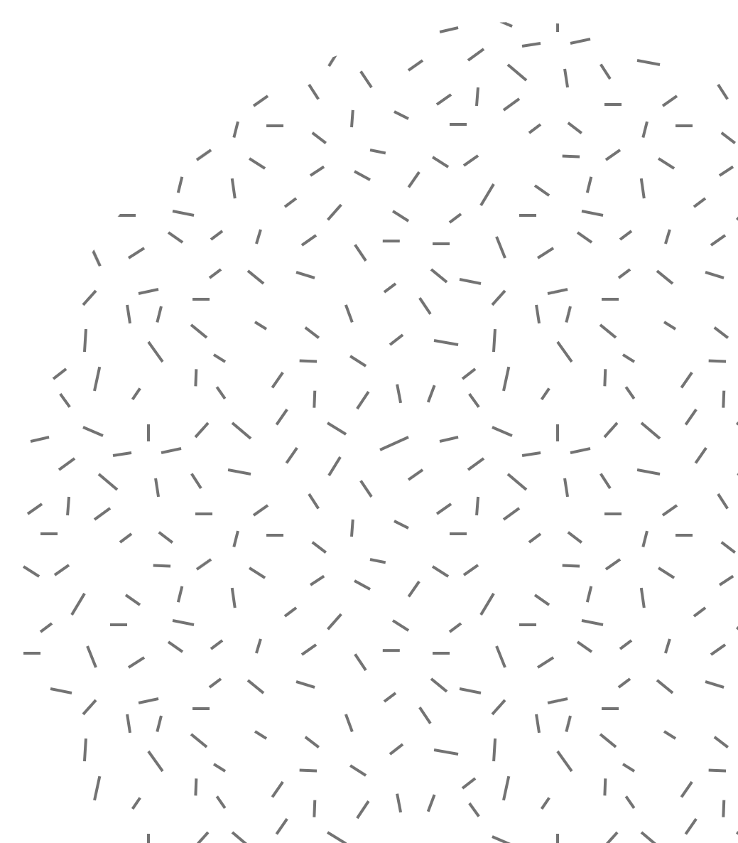
Ensemble Methods
Ensemble: A group of items viewed as a whole rather than individually

Slide 3
🌟 What Are Ensemble Methods?
Ensemble methods are like asking multiple experts instead of relying on just one. The idea is:
"Many weak models combined together can give a strong model.“
In machine learning, an ensemble combines the predictions of several models to make a better overall prediction.
Simple Real-Life Example:
Imagine you want to decide whether to watch a movie.
You ask 1 friend: They say, "Maybe it's good."
But if you ask 10 friends, and 7 say it's great, you're more confident.
This is exactly what ensemble methods do — combine multiple opinions (models) to make a better decision.

Slide 4
Why Use Ensemble Methods?
Reduce errors
Improve accuracy
Handle overfitting and underfitting

Slide 5
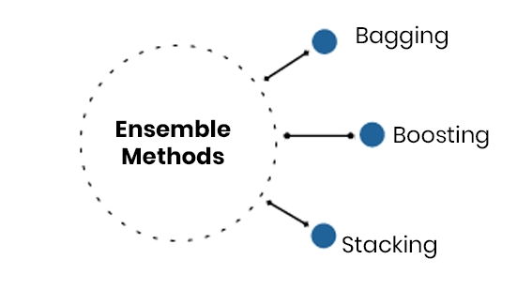

Slide 6
Bagging: (Bootstrap Aggregating)
Bootstrap Aggregating is a machine learning ensemble method that helps improve accuracy and reduce overfitting by:
Creating many versions of a model (like decision trees),
Training each on a random sample of the data,
Combining their predictions (e.g., by majority vote or averaging).
Real-Life Analogy:
Imagine a teacher wants to predict whether students will pass based on their study hours.
Instead of asking one tutor to guess, the teacher asks 10 different tutors, each given slightly different groups of students (with repetition allowed). Then, the teacher combines all their answers to make a final decision.
💡 This teamwork leads to a better and more balanced prediction.

Slide 7
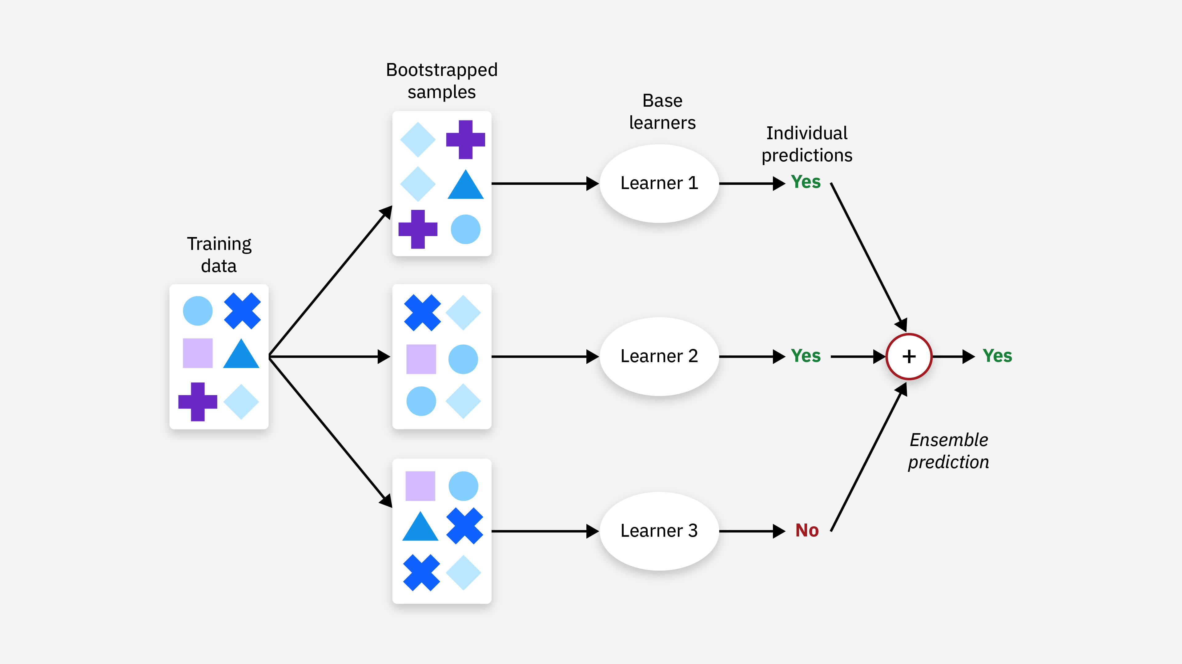
Bagging (Parallel)

Slide 8
Example:
Student | Study Hours | Pass (Yes/No)
A | 1 | No
B | 2 | No
C | 3 | Yes
D | 4 | Yes
E | 5 | Yes

Slide 9
Step-by-Step Bagging Process:
Bootstrap Sampling:
Randomly create several new datasets (say, 3) with replacement from the original.
Example Samples:
Model 1: A, C, E, B, E
Model 2: D, B, B, C, A
Model 3: E, D, C, D, A
Train Models:
Train a separate Decision Tree on each dataset.
Make Predictions:
Let’s say we want to predict whether a student who studies for 3 hours will pass.
Model 1: Yes
Model 2: No
Model 3: Yes
Aggregate Predictions:
Use majority voting for classification.
Final Result = Yes (because 2 out of 3 say Yes)

Slide 10
🌳 Famous Example: Random Forest
Random Forest = Bagging applied to Decision Trees
It’s one of the most powerful and popular machine learning algorithms today

Slide 11
2. Boosting:
Boosting is an ensemble learning method where:
Models are built one after another, not in parallel (like in Bagging).
Each new model focuses on correcting the mistakes made by the previous models.
All models are combined to give the final strong prediction.
💡 Goal: Turn a bunch of weak learners into one strong learner.

Slide 12
Real-Life Analogy for Students:
Imagine a student is preparing for a test:
In Test 1, they score 40%.
They check their mistakes, focus more on those topics, and take Test 2.
Again, they focus on the mistakes from Test 2, and so on...
Eventually, their score keeps improving!
This is exactly how Boosting works — learning from errors step by step.

Slide 13
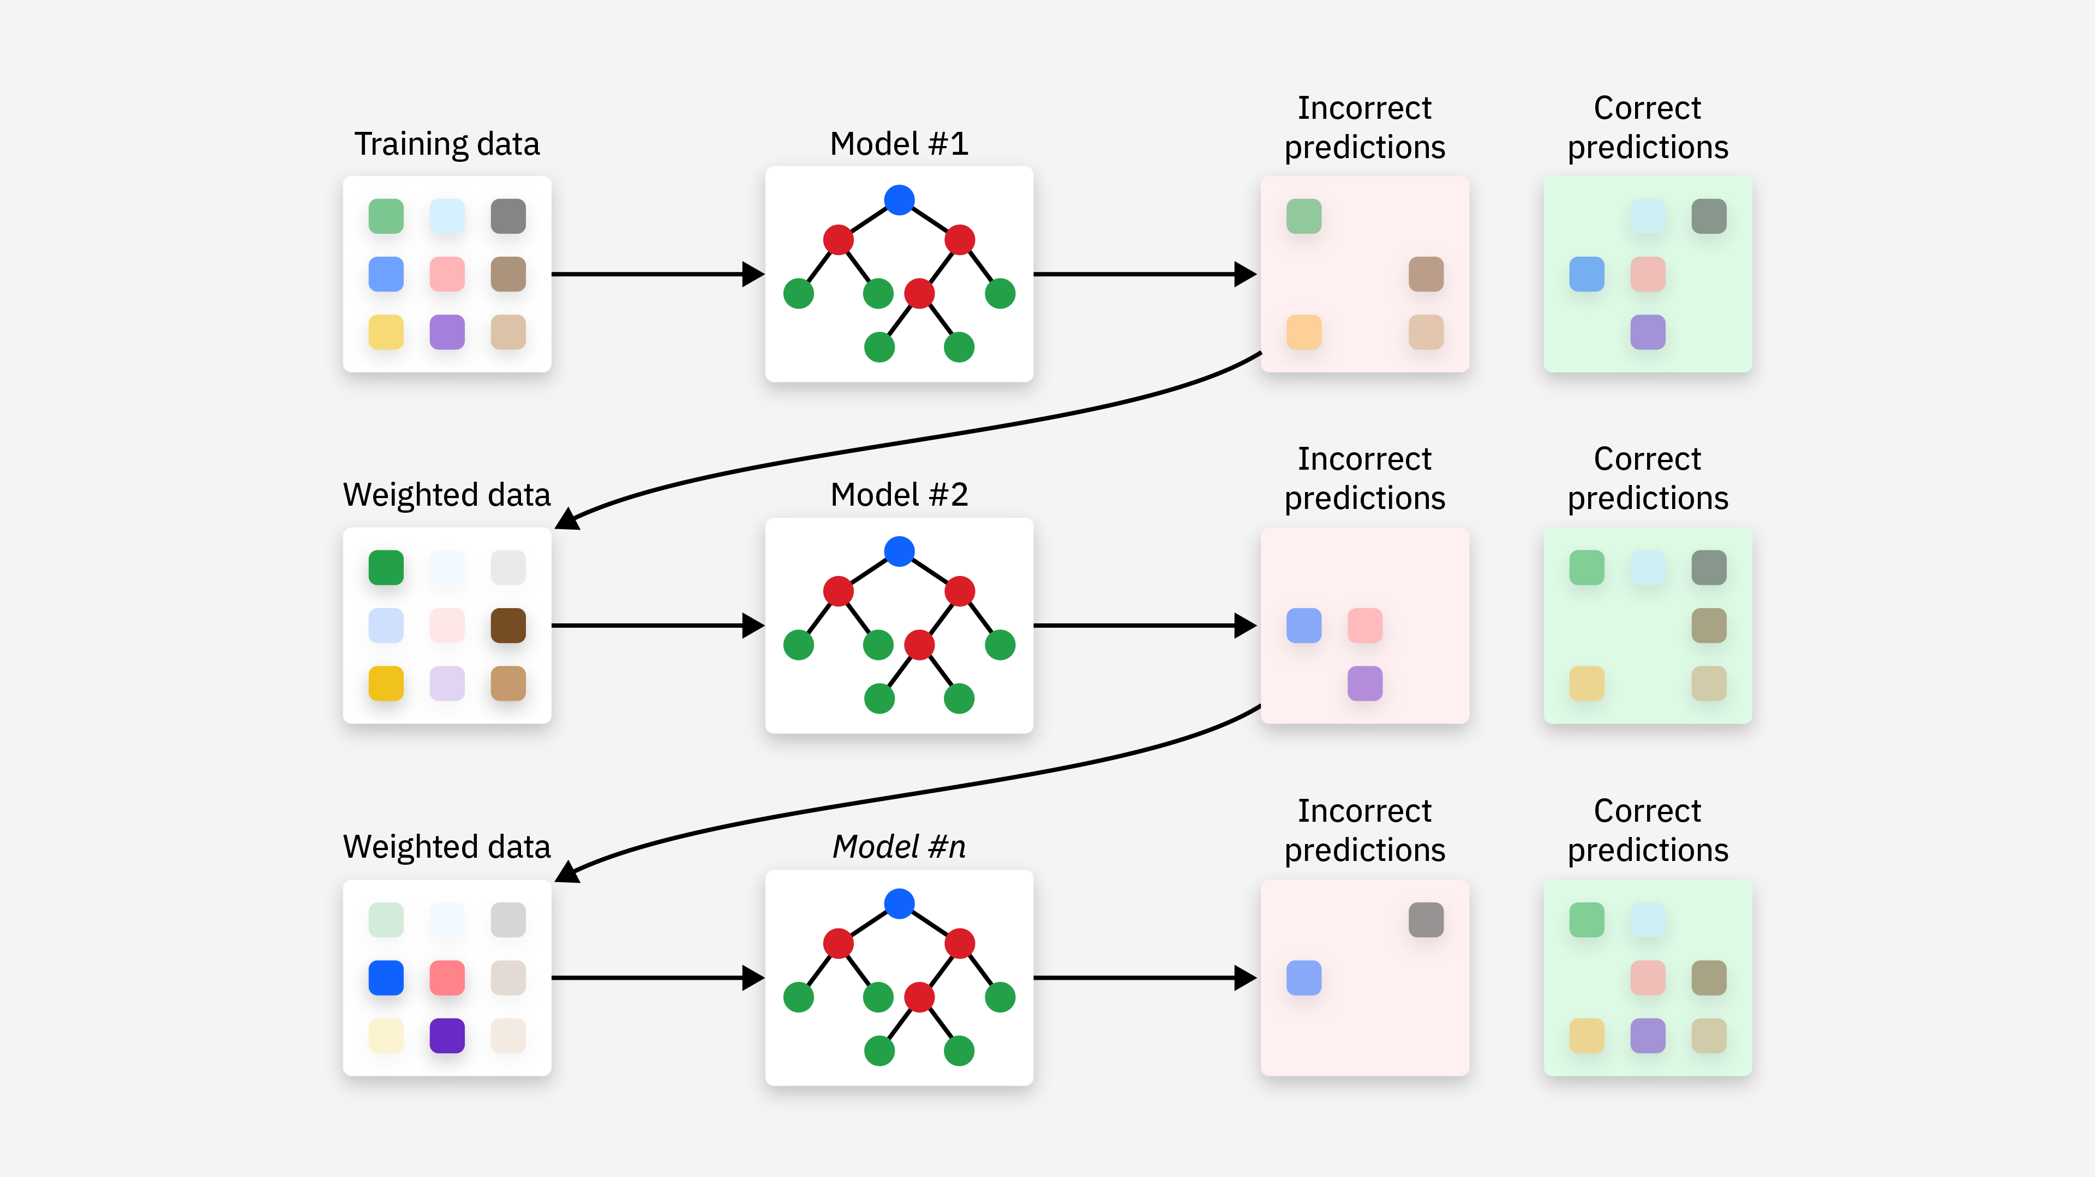
Boosting (Sequential)

Slide 14
Simple Example
Let’s say you're trying to predict if a person will buy a product based on features like:
Person | Age | Income | Buys (Yes/No)
A | 25 | Low | No
B | 30 | Medium | Yes
C | 35 | High | Yes
D | 22 | Low | No
E | 40 | High | Yes

Slide 15
Step-by-Step Boosting Process:
Start with equal weights for all data points. Equal weights means each training data point is initially considered equally important when training the first model.
Train a weak model (e.g., a shallow decision tree):
Suppose it makes mistakes on Person B and E.
Increase the weight of those wrongly predicted examples.
Train a new model focusing more on B and E.
Repeat this process for a few rounds.
Combine all models’ predictions using a weighted vote or sum.
Each model gets a say — better models get more say.

Slide 16
🔥 Popular Boosting Algorithms:
Algorithm | Description
AdaBoost | Adjusts weights of data points after every model
Gradient Boosting | Minimizes the error using gradient descent
XGBoost | A very fast and optimized version of gradient boosting
LightGBM, CatBoost | Other fast and efficient boosting algorithms

Slide 17
Gradient Boosting Machines (GBM):
Gradient Boosting Machine (GBM) is a powerful boosting technique used to build strong prediction models by:
Building models sequentially
Each model tries to fix the errors of the previous one
It uses gradient descent to minimize the error step-by-step
What is Gradient Descent?
Gradient Descent is an optimization algorithm used to minimize a loss (error) function by adjusting the model's parameters (like weights in linear regression or neural networks).
We are trying to find the best model parameters that result in the least error on training data.
Gradient Descent helps by taking small steps in the direction where the error decreases.

Slide 18
💡 Easy Analogy (Real-Life)
Think of a student improving their test score:
After the first test, they check their mistakes.
They then study exactly where they went wrong, and in the next test, they do slightly better.
This process continues until the student is well-prepared.
📘 That’s exactly what Gradient Boosting does — it learns from mistakes and improves gradually.
Gradient Boosting builds one model at a time, each one learning from the mistakes of the last. It improves slowly using gradient descent to make strong predictions.

Slide 19
How GBM Works (Simple Steps)
Let’s assume we're predicting house prices based on size:
House | Size (sqft) | Price ($1000s)
A | 1000 | 100
B | 1200 | 120
C | 1500 | 150

Slide 20
Step-by-Step Explanation of GBM:
Step 1: Start with a weak model
A simple model (like a straight line) is created.
It may predict:
A: 90
B: 110
C: 130
Step 2: Calculate errors (residuals)
Actual – Predicted:
A: 100 – 90 = +10
B: 120 – 110 = +10
C: 150 – 130 = +20
This is the residual (what the model got wrong).
Step 3: Build a new model to predict the residuals
Now, a small model is trained to predict these errors.
It predicts:
A: +8
B: +9
C: +18

Slide 21
Step 4: Add this correction to the previous model
Final predictions:
A: 90 + 8 = 98
B: 110 + 9 = 119
C: 130 + 18 = 148
This new model is closer to the real answer.
Repeat:
Repeat the process for more iterations, each time correcting the errors of the last step.

Slide 22
Why It’s Called "Gradient" Boosting?
GBM uses the idea of gradient descent, just like in deep learning.
It looks at the gradient (slope) of the loss function (error), and moves in the opposite direction to reduce the error.
Explanation:
Think of it like climbing down a hill (gradient = slope, descent = go down) to reach the lowest point (minimum error).
You are trying to find the best model parameters that result in the least error on training data.
Gradient Descent helps by taking small steps in the direction where the error decreases.
In simple words: “It walks downhill to reduce mistakes.”

Slide 23
2. Extreme Gradient Boosting (XGBoost)
XGBoost stands for eX**treme Gradient Boosting.
It is an improved version of Gradient Boosting designed to be:
Faster
More efficient
More accurate
Scalable for large datasets
It’s widely used in real-world projects as XGBoost is an advanced, optimized version of gradient boosting that is faster, smarter, and often more accurate. It's one of the best tools in a data scientist’s toolbox.

Slide 24
Simple Analogy:
Imagine you already know how to learn from mistakes step-by-step (like Gradient Boosting). Now imagine:
You also optimize your time better
Use less memory
Focus only on important mistakes
And do all this very fast
That’s exactly what XGBoost does! It’s like a supercharged version of Gradient Boosting.

Slide 25
How XGBoost Works:
Start with an initial prediction (e.g., average of target values).
Calculate the gradient (i.e., error) using a loss function.
Build a tree to predict the gradient (error).
Add the new tree's prediction to the old one.
Repeat this process for several trees, each improving the result.
Apply regularization to control complexity and reduce overfitting.

Slide 26
Example: Predicting House Prices
House | Size (sqft) | Price ($1000s)
A | 1000 | 100
B | 1200 | 120
C | 1500 | 150

Slide 27
XGBoost:
Starts with a base prediction (say 120)
Calculates error for each house
Builds trees that predict the error (residuals)
Adds corrections step-by-step
Uses regularization to avoid overfitting

Slide 28
Support Vector Machines:
Support Vector Machines (SVM) is a powerful supervised machine learning algorithm used for classification and regression tasks. The primary objective of SVM is to find the optimal hyperplane that best separates different classes in the feature space.
The goal of the SVM algorithm is to create the Best line or decision boundary (hyperplane) that can segregate the n-dimensional space into classes so that we can easily put the new data point in the correct category in the future. The goal is to maximize the margin between the classes — hence, the name “maximum margin classifier.”
SVM is a model, which can do linear classification as well as regression. SVM is based on the concept of a surface, called a hyperplane, which draws a boundary between data instances plotted in the multi-dimensional feature space. The output prediction of an SVM is one of two conceivable classes which are already defined in the training data. In summary, the SVM algorithm builds an N-dimensional hyperplane model that assigns future instances into one of the two possible output classes.
Note: The SVM model is does not depends on the single Hyperplane. Instead it will create 2 more hyperplane where, one is created which is passing through the nearest point in one class or category and one more is for another classs or category.

Slide 29
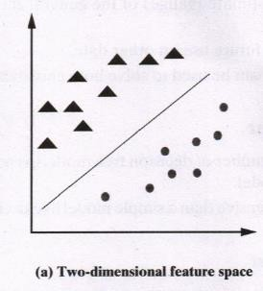
Classification using Hyperplanes:
In SVM, a model is built to discriminate or differentiate the data instances belonging to different classes.
Let us assume for the sake of simplicity that the data instances are linearly separable. In this case, when mapped in a two-dimensional space, the data instances belonging to different classes fall in different sides of a straight line drawn in the two dimensional space as depicted in Figure (a).

Slide 30
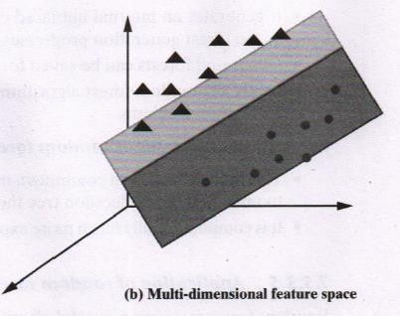
If the same concept is extended to a multi-dimensional feature space, the straight line dividing data instances belonging to different classes transforms to a hyperplane as depicted in Figure (b). Thus, an SVM model is a representation of the input instances as points in the feature space, which are mapped so that an apparent gap between them divides the instances of the separate classes.
In other words, the goal of the SVM analysis is to find a plane, or rather a hyperplane, which separates the instances on the basis of their classes. New examples or new instances are then mapped into that same space and predicted to belong to a class on the basis of which side of the gap the new instance will fall on.
In summary, in the overall training process, the SVM algorithm analyses input data and identifies a surface in the multidimensional feature space called the hyperplane. There may be many possible hyperplanes, and one of the challenges with the SVM model is to find the optimal hyperplane.

Slide 31
Important Terminologies:
Marginal Plane: In Support Vector Machines (SVM), the marginal plane refers to the hyperplane or decision boundary that maximizes the margin between the support vectors of different classes. The margin is the distance between the decision boundary and the closest data points or support vectors from each class.
Support Vectors: The data points which are passing through the Marginal Plane is called Support Vectors. It is possible to have more than one Data Points.
Marginal Distance :In Support Vector Machines (SVM), the marginal distance refers to the distance between the data point and the decision boundary (hyperplane) of the SVM model.
Higher the marginal distance is more the Generalized our Model is.

Slide 32
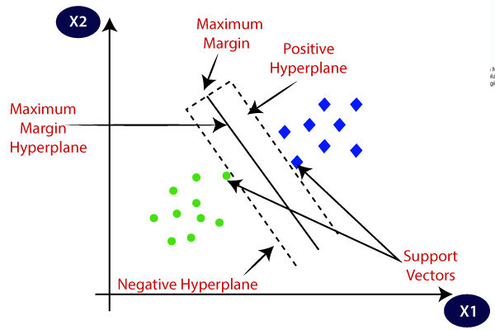
Marginal plane
Note: To Draw a Marginal Plane to circle, Consider a circle which is near to or close to the square. Similarly, to draw Marginal plane to square consider the square near to the circle class.

Slide 33
How SVM Works – Step-by-Step (for Classification)
Input the data.
Find the optimal hyperplane that best separates the classes.
If data is not linearly separable, apply a kernel function to transform it to higher dimensions.
SVM chooses the hyperplane that has the maximum margin.
Use this hyperplane to predict unseen data.

Slide 34
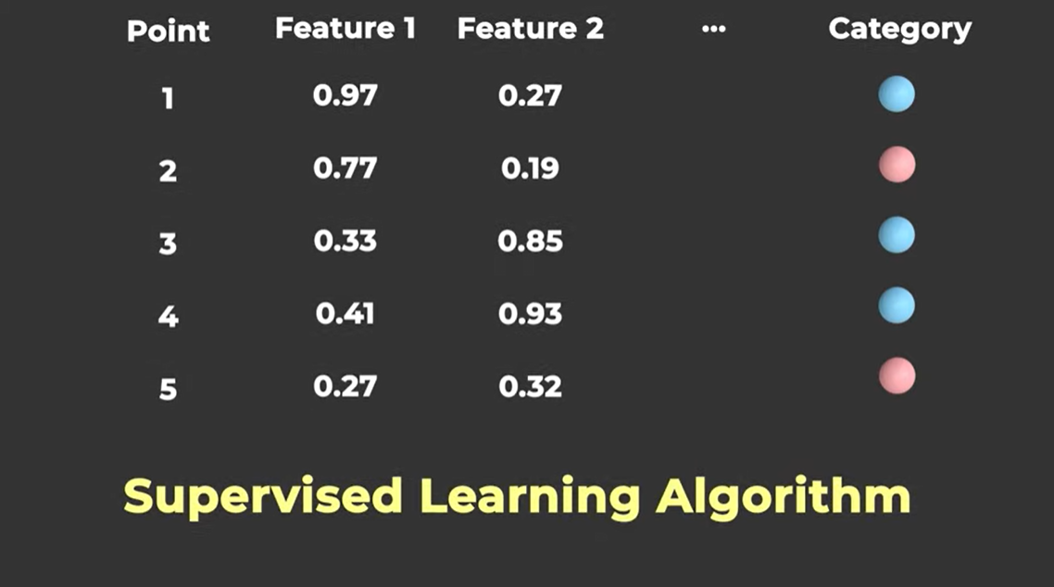

Slide 35
Important to Note:
Support Vector Machines (SVMs) classify new data points by determining which side of the hyperplane they fall on. After the SVM has been trained on a dataset and has identified the optimal hyperplane that separates the classes, it uses this hyperplane to make predictions on unseen data.
When a new data point is presented to the SVM for classification, the model evaluates the position of the point relative to the hyperplane. If the point lies on one side of the hyperplane, it is classified as belonging to one class; if it lies on the other side, it is classified as belonging to the other class. The distance of the data point from the hyperplane determines the confidence level of the classification.

Slide 36
let's consider a simple example where we have two classes: red and blue points distributed in a two-dimensional space. The goal is to train an SVM to classify new data points as either red or blue based on their features.
Suppose we have the following training data:
Red points: (1, 2), (2, 3), (3, 3)
Blue points: (2, 1), (3, 2), (4, 1)
After training the SVM, it finds the optimal hyperplane that separates the red and blue points in the feature space. Let's say the equation of this hyperplane is:
2X1​ + 3X2​=8
Now, when a new data point, let's say (2.5, 2.5), is presented to the SVM for classification, the SVM evaluates its position relative to the hyperplane.

Slide 37
If the point lies above the hyperplane (i.e., 2×2.5+3×2.5>8), it will be classified as a red point.
If the point lies below the hyperplane (i.e., 2×2.5+3×2.5<8), it will be classified as a blue point.
In this way, the SVM classifies new data points based on which side of the hyperplane they fall on.

Slide 38
Linear vs. Non-Linear SVM:
Linear SVM: Used when data is linearly separable.
Non-Linear SVM: Used when data is not linearly separable — handled using kernel tricks.

Slide 39
1. Linear SVM
Linear SVM is used when the data is linearly separable, i.e., it can be divided by a straight line (in 2D) or a hyperplane (in higher dimensions).
Example: Consider a dataset with two features (X1, X2) and two classes:
Note: Linear Means when value of x1 increase/ decreases then value of x2 will also increases/decreases
X1 | X2 | Label
1 | 2 | 0
2 | 3 | 0
4 | 6 | 1
3 | 5 | 1

Slide 40
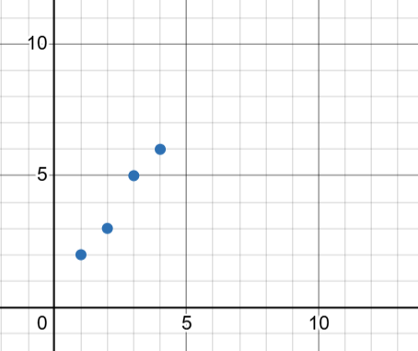
Visually, we can draw a straight line separating these two groups.
Here, the classes are linearly separable, so Linear SVM will draw a straight line (hyperplane) that maximizes the margin between the two classes.
Use Linear SVM When Data is clearly separable with a straight line.

Slide 41
2. Non-Linear SVM
Non-linear SVM is used when the data is not linearly separable. It uses kernel functions to transform the data into higher dimensions where a linear hyperplane can separate the classes.
Example: Consider this data
X1 | X2 | Label
0 | 1 | 0
1 | 0 | 0
1 | 1 | 1
-1 | 0 | 0
0 | -1 | 0

Slide 42
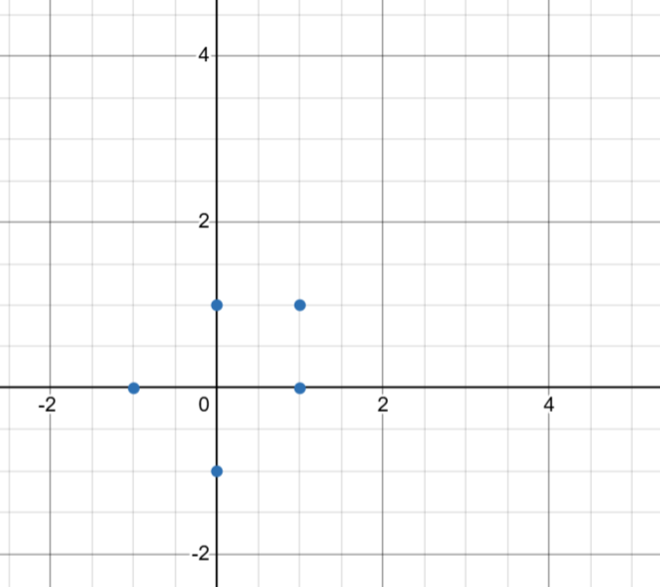
Visually:
Here, the data is circularly distributed, and no straight line can separate class 0 and 1.
But if we apply the Radial Basis Function (RBF) kernel, it will map the data to a higher-dimensional space, where a linear separator exists.

Slide 43
Kernel Trick:
The Kernel Trick allows SVM to operate in a higher-dimensional space without explicitly computing the coordinates of the data in that space. Instead, it uses a mathematical function (kernel) to calculate the dot product of two vectors as if they were in that higher-dimensional space.
Why?
So we can apply a linear separator in high dimensions even if the data is non-linear in low dimensions.
Instead of manually transforming data, SVM uses kernel functions (like RBF, Polynomial, Sigmoid) to compute inner products in higher-dimensional space efficiently.

Slide 44
Example:
Here, the data is circularly distributed, and no straight line can separate class 0 and 1.
Here, you cannot draw a straight line to separate the classes. But if we map this data to a 3D space, we might be able to draw a flat plane that separates the classes perfectly.
But computing in 3D (or higher) is computationally expensive!
That’s where the Kernel Trick comes in:
It lets us calculate the dot product in higher-dimensional space without actually transforming the data to that space.

Slide 45
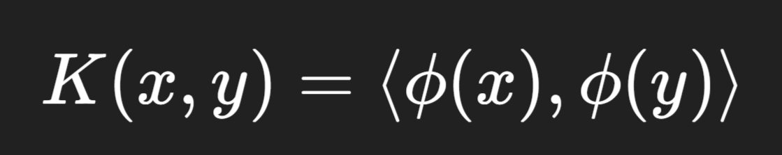
Key Idea:
Instead of transforming features using a function ϕ(x), the kernel function K(x, y) computes:
Where:
x and y are data points in the original space.
ϕ(x) is a mapping to a higher-dimensional space.
⟨ , ⟩ denotes the inner product (dot product).

Slide 46
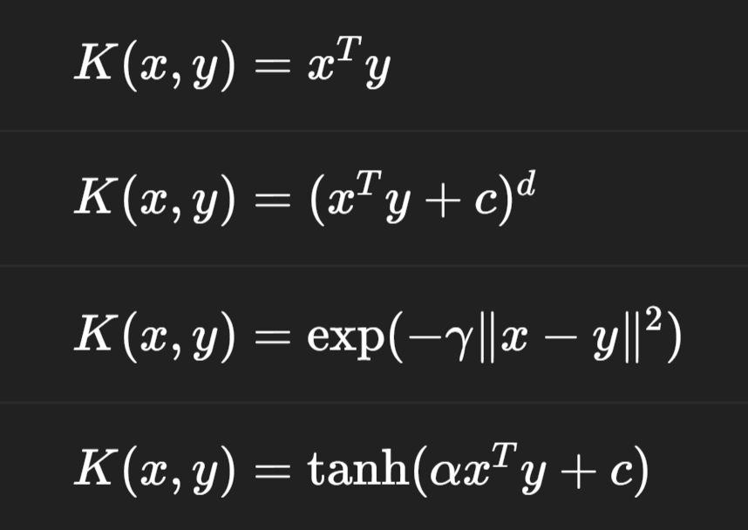
Common Kernel Functions
Kernel Name | Formula | Use Case
Linear |  | For linearly separable data
Polynomial |  | Captures polynomial relationships
RBF (Gaussian) |  | For complex, non-linear boundaries
Sigmoid |  | Mimics neural network

Slide 47
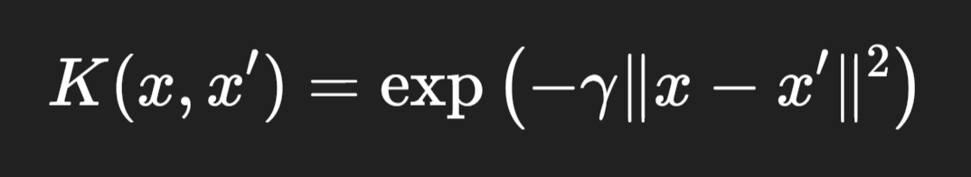
RBF (Radial Basis Function) Kernel:
The RBF kernel, also known as the Gaussian kernel, is a non-linear kernel function used in Support Vector Machines (SVMs) and other machine learning models to measure the similarity between two data points.
It is defined as:
Where:
𝑥 and 𝑥′ are input feature vectors
∥x−x′∥2 is the squared Euclidean distance between the two vectors
𝛾 is a free parameter that controls the influence of a single training example.

Slide 48
Intuition:
The RBF kernel measures similarity between two points.
The closer the points, the higher the similarity (near 1).
The farther apart, the lower the similarity (approaches 0).
This allows SVM to create curved decision boundaries and separate data that isn’t linearly separable.

Slide 49
RBF in Action (Steps):
Input the data.
Apply the RBF kernel to compute the similarity between all pairs of points.
Map the data implicitly to a higher-dimensional space.
Find the optimal hyperplane in that space.
Use it for classification in the original space.

Slide 50
Model evaluation metrics:
Accuracy
Precision
Recall
F1-score
ROC-AUC
These are commonly used model evaluation metrics in classification, where the goal is to predict continuous values (e.g., predicting house prices, temperatures, etc.).

Slide 51
Tuning or Hyperparameter Tuning:
Tuning also called Hyperparameter Tuning is the process of finding the best combination of model settings (called hyperparameters) that result in the best performance of a machine learning model.
In Simple Words:
Just like adjusting the settings on a car (like tire pressure or suspension) for better performance, tuning adjusts the model settings to get the best results on your data.
Why Do We Need Tuning?
Most machine learning models, like SVM, Random Forest, or Neural Networks, have hyperparameters that you must set before training.
These settings affect how the model learns from the data.
Tuning helps find the values that give highest accuracy or lowest error on validation data.

Slide 52
Hyper parameter tuning using GridSearchCV:
Hyperparameter tuning is the process of selecting the best set of hyperparameters for a machine learning model to improve its performance. One popular and systematic method to do this is GridSearchCV.
What is a Hyperparameter:
A hyperparameter is a configuration value set before training a machine learning model. It controls the behavior or structure of the model but is not learned from the data.
For Example: In KNN Algorithm we have to set the value for K before the training starts which is called as Hyperparameter.
Note: Hyperparameters can significantly affect the performance, training speed, and generalization of your model.

Slide 53
Introduction to Neural Networks

Slide 54
What is Deep Learning?
Deep Learning is a branch of Machine Learning that uses artificial neural networks with many layers (hence "deep") to learn from data and make predictions or decisions.
Neural Networks:
A Neural Network (NN) is a computational model inspired by the way the human brain works. It consists of layers of interconnected "neurons" (also called nodes), and it is used to recognize patterns, make decisions, and learn from data.
Neural networks are the foundation of Deep Learning, a subset of Machine Learning.

Slide 55
Why ANN:
Machine learning, as we have seen, mimics the human form of learning. On the other hand, human learning, or for that matter every action of a human being, is controlled by the nervous system.
In any human being, the nervous system coordinates the different actions by transmitting signals to and from different parts of the body.
The nervous system is constituted of a special type of cell, called neuron or nerve cell, which has special structures allowing it to receive or send signals to other neurons. Neurons connect with each other to transmit signals to or receive signals from other neurons. This structure essentially forms a network of neurons or a Neural Network.

Slide 56
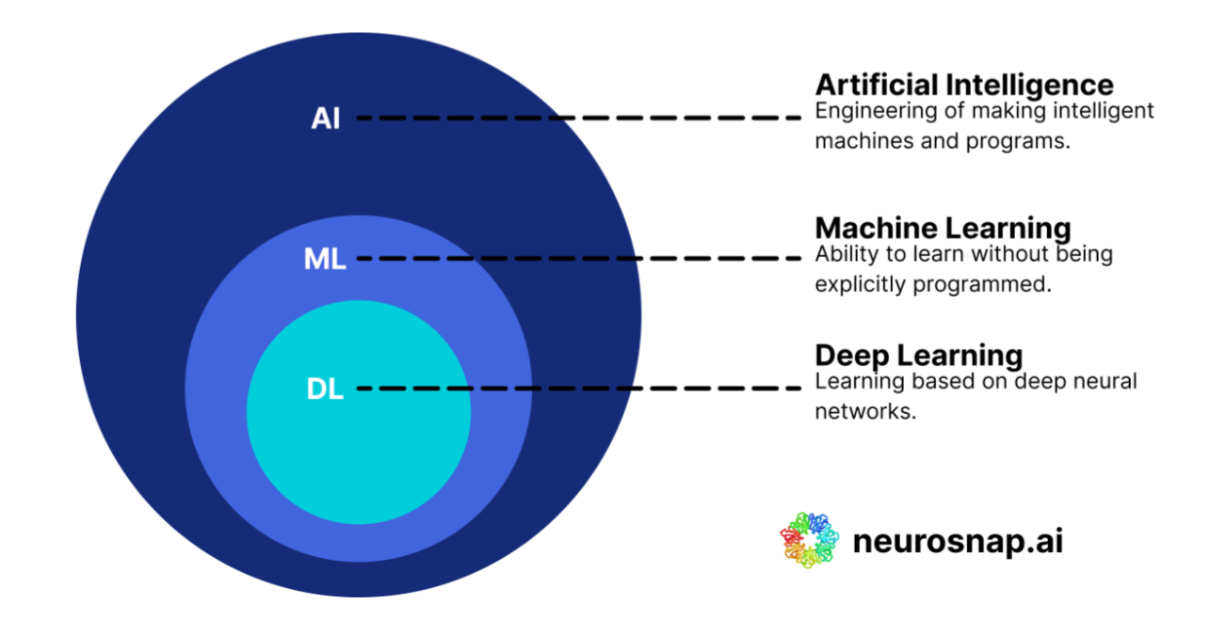

ML vs DL
If Machine Learning is like teaching a child how to solve math using a formula, Deep Learning is like letting the child learn patterns from many examples, without giving them the formula — and they eventually figure it out.

Slide 57
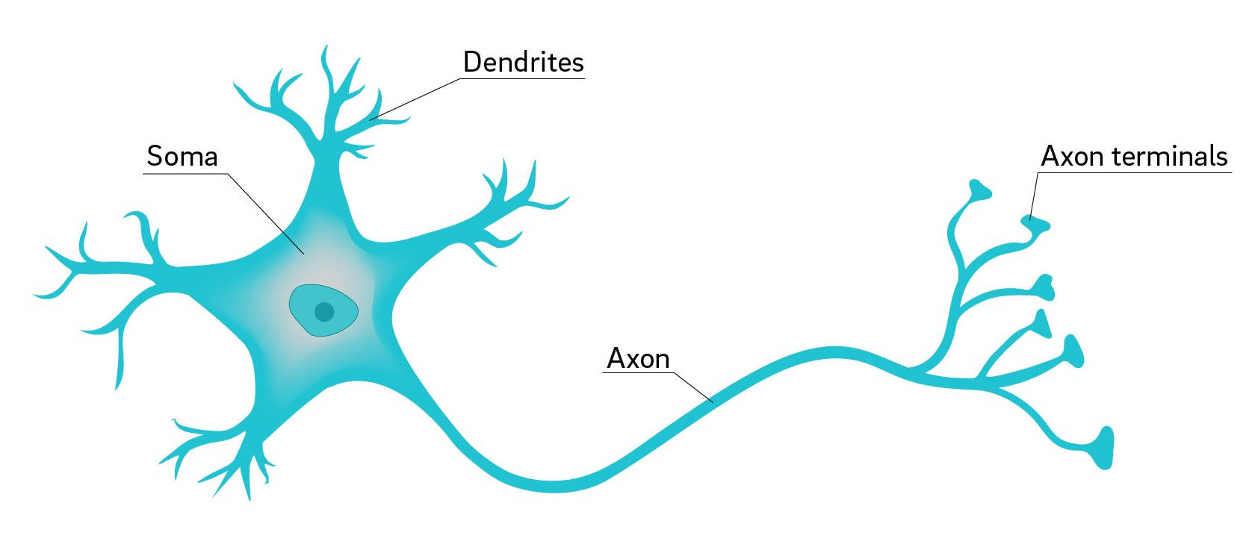
THE BIOLOGICAL NEURON : The human nervous system is divided into two main parts:
The Central Nervous System (CNS): which includes the brain and spinal cord.
The Peripheral Nervous System: which includes nerves and ganglia (clusters of nerve cells) outside the brain and spinal cord.
Structure of a 1 Neuron

Slide 58
Note:
The CNS integrates all information, in the form of signals, from the different parts of the body.
The peripheral nervous system, on the other hand, connects the CNS with the limbs and organs.
Neurons are basic structural units of the CNS.
A neuron is able to receive, process, and transmit information in the form of chemical and electrical signals.

Slide 59
A Biological Neuron has a cell body or soma to process the impulses or signals, dendrites to receive them, and an axon that transfers them to other neurons.
The Above figure presents the structure of a neuron. It has three main parts to carry out its primary functionality of receiving and transmitting information:
A biological neuron has a cell body or soma to process the impulses, dendrites to receive them, and an axon that transfers them to other neurons.
Dendrites : to receive signals from neighboring or surrounding neurons and the axon transmits the signal to the other neurons.
Soma : Main body of the neuron which accumulates or collects the signals coming from the different dendrites. It ‘fires’ when a sufficient amount of signal is Collected.
Axon :The last part of the neuron which receives signal from soma, once the neuron ‘fires’ and passes it on to the neighboring neurons through the axon terminals (to the adjacent dendrite of the neighboring neurons).
There is a very small gap between the axon terminal of one neuron and the adjacent dendrite of the neighboring neuron. This small gap is known as synapse. The signals transmitted through synapse may be excitatory or inhibitory.

Slide 60
Why Understand Biological Neural Networks?
For creating mathematical models for artificial neural networks, theoretical analysis of biological neural networks is essential as they have a very close relationship. And this understanding of the brain’s neural networks has opened horizons for the development of artificial neural network systems and adaptive systems designed to learn and adapt to the situations and inputs.

Slide 61
Artificial Neuron or Perceptron :
An artificial neuron, often referred to as a perceptron, is a fundamental building block of artificial neural networks (ANNs). Modeled after biological neurons in the human brain, artificial neurons are mathematical entities designed to process and transmit information.
The biological neural network has been modelled in the form of ANN with artificial neurons simulating the function of biological neurons.
Artificial Neural Network (ANN): An artificial neural network (ANN), often simply referred to as a neural network, is a computational model inspired by the structure and function of biological neural networks in the human brain. It consists of interconnected nodes, called neurons or units, organized in layers. ANN processes information in a manner similar to how the human brain operates, enabling it to learn from data and make predictions or decisions.
Key components and concepts of an ANN:
Neurons (Nodes)
Connections (Edges)
Layers

Slide 62
Artificial Neural Networks: ANN
The human brain works like a supercomputer, allowing us to make quick decisions and perform complex actions. For example, think about a cricket fielder making a great catch. They have to calculate where the ball will land, how fast it's moving, and then decide when and where to jump to catch it. This requires a lot of skill and quick thinking.
Even simpler tasks, like swimming in a pool, require a lot of coordination and decision-making. Your brain has to figure out the right body movements and breathing techniques to swim effectively, especially since water is much denser than air. Despite these challenges, our brains are able to handle these tasks because of their complex network of neurons, which allow us to process information and make decisions quickly.
This amazing ability of our brains has inspired the creation of Artificial Neural Networks (ANN). These are like computer models of the brain, made up of artificial neurons. They're designed to mimic how our brains work, using digital versions of neurons to process information and make decisions. These artificial neurons are the basic building blocks of artificial neural networks.

Slide 63
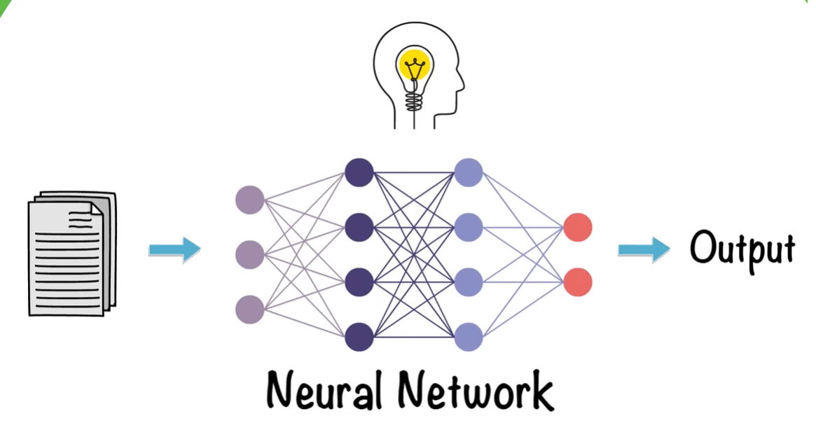
NEURAL NETWORKS:
Neural Networks form the base of Deep Learning, Which is a sub-field of ML where the Algorithms are inspired by the structure of the Human Brain. Neural Networks take in data and train themselves to recognize the patterns in this data and then predicts the output for new set of similar data or unseen data.

Slide 64
Neurons (Nodes):
Neurons are the basic computational units of a neural network. Each neuron receives input signals from other neurons or external sources, processes them, and produces an output signal. In artificial neural networks, neurons are typically organized into layers: input layer, hidden layers (if any), and output layer.
Connections (Edges):
Connections represent the flow of information between neurons in different layers. Each connection is associated with a weight that determines the strength of the connection. These weights are adjusted during the learning process to optimize the network's performance.
Layers:
A neural network is composed of multiple layers of neurons. The input layer receives input data, the output layer produces the network's output, and one or more hidden layers (if present) perform intermediate computations. The number of layers and the number of neurons in each layer can vary depending on the complexity of the problem and the architecture of the network.

Slide 65
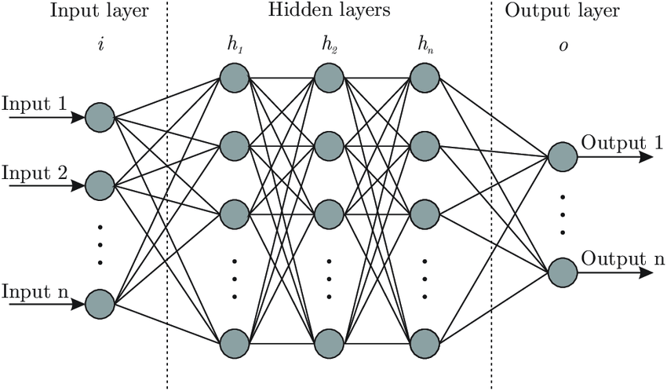
Structure of an Artificial Neural Network: is a Network of Neurons
The architecture of an artificial neural network (ANN) refers to its structural layout, including the arrangement of neurons (nodes) and the connections between them. The architecture determines how information flows through the network and how computations are performed.
Input Layer
Hidden Layer
Output Layer

Slide 66
Smple Real-world example: Handwritten Digit Recognition (0–9)
Problem: Given an image of a handwritten digit, predict what digit (0 to 9) it represents.
Input Layer (i):
Each input neuron represents a pixel from the image.
If we use a 28×28 grayscale image, we have 784 input values (28×28).
So, Input 1 to Input n = pixel values (0 to 255 scaled between 0 and 1).

Slide 67
2. Hidden Layers (h₁, h₂, ..., hₙ):
These layers do the computation.
They apply weights, biases, and activation functions to learn features like curves, corners, and shapes in the digit.
Example:
First hidden layer might detect edges,
Second one might identify round or straight shapes,
Deeper layers combine this into understanding “Is this a 3 or an 8?”

Slide 68
3. Output Layer (o):
Contains 10 neurons, one for each digit (0 to 9).
Uses a softmax activation function to give probability scores for each digit.
Output example:
Here, the highest probability (0.91) is at index 3 → the model predicts the digit is 3.

Slide 69
Summary of Each Layer in the Diagram:
Layer | What it does | In our example
Input Layer | Takes image pixel values | 784 pixels from a 28×28 image
Hidden Layers | Detect patterns and features | Edges, curves, parts of digits
Output Layer | Predicts the digit | 0 to 9, based on confidence

Slide 70
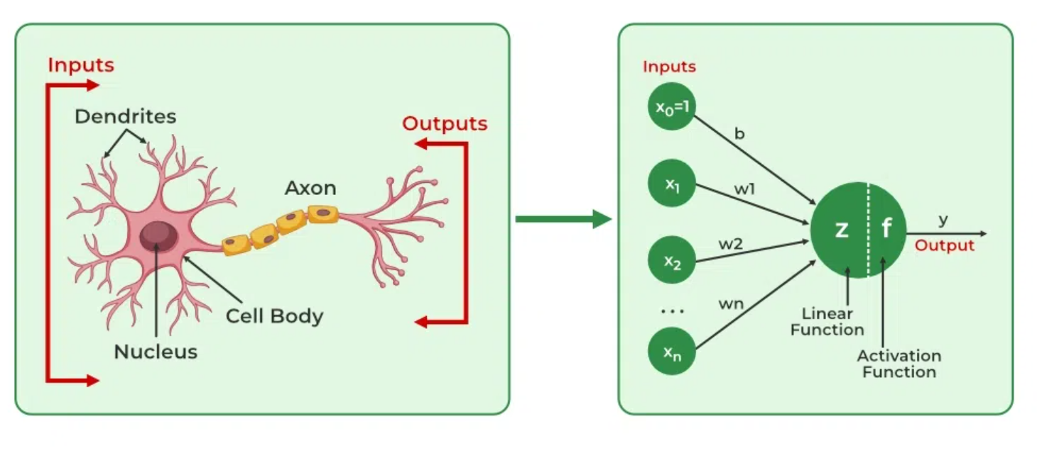
Biological Neuron
Artificial Neural Networks

Slide 71
Building and Training Neural Networks using TensorFlow and Keras
What are TensorFlow and Keras?
Think of TensorFlow as the engine, and Keras as the user-friendly steering wheel.
Tool | What it is | Purpose
TensorFlow | An open-source ML library by Google | To build and train ML models
Keras | A high-level API running on top of TensorFlow | Makes building neural networks easy

Slide 72
Neural Network Workflow (Big Picture)
Import libraries
Prepare data
Build the model
Compile the model
Train the model
Evaluate the model
Make predictions

Slide 73
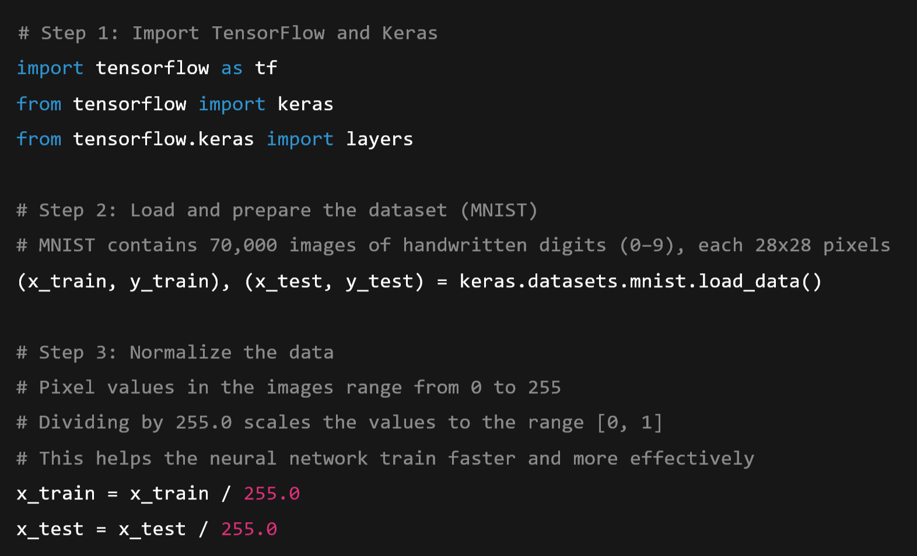
Simple Example: Classifying handwritten digits (MNIST dataset)

Slide 74
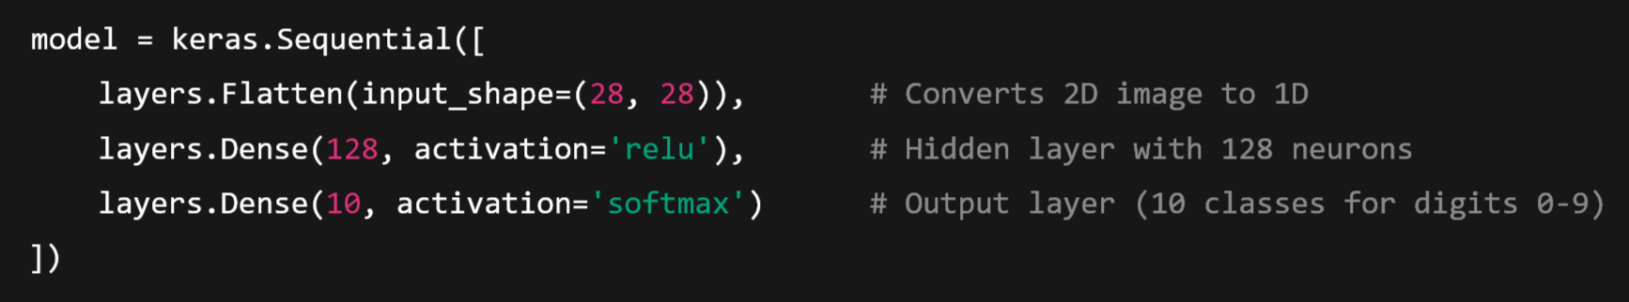
Build the Neural Network Model

Slide 75
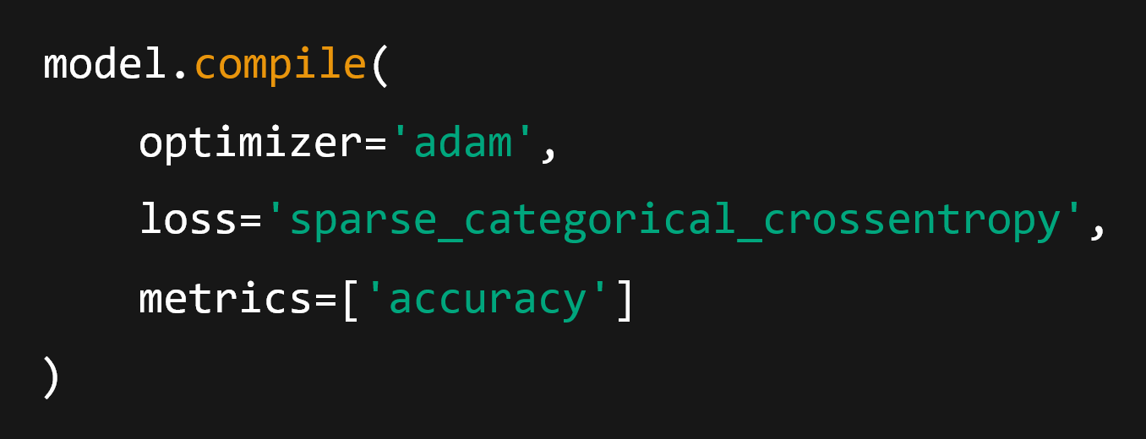
Compile the Model

Slide 76
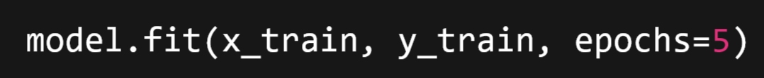
Train the Model:
Trains the model with training data for 5 passes (epochs). Epochs tells the model to go through the entire training dataset 5 times.

Slide 77
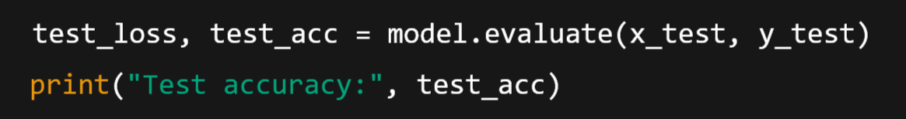
Evaluate the Model
Make Predictions:

Slide 78
Summary
Step | What You Do | In Our Example
1. Import | Load TensorFlow/Keras | import tensorflow as tf
2. Load Data | Use built-in dataset | MNIST digits
3. Build Model | Use Sequential and layers | Flatten → Dense (ReLU) → Dense (Softmax)
4. Compile | Choose loss, optimizer, metrics | Adam, accuracy
5. Train | Fit model with data | .fit()
6. Evaluate | Test accuracy | .evaluate()
7. Predict | Use .predict() for new data | Output digit

Slide 79
Architectures in Deep Learning:
Deep learning encompasses a wide range of neural network architectures, each designed to solve specific types of problems and address various challenges in machine learning. These architectures differ in their structure, connectivity, and functionality, allowing them to excel in different domains and tasks.
Here are some popular Techniques in deep learning:
Deep Neural Network
Convolutional Neural Networks (CNNs)
Recurrent Neural Networks (RNNs)
Deep Belief Network(DBN)

Slide 80
Convolutional Neural Network (CNN)
A Convolutional Neural Network (CNN) is a type of deep learning model that is specially designed to process image data (or grid-like data such as audio or video).
CNNs are very good at recognizing patterns in images — like edges, colors, shapes, and objects.
Why use CNNs instead of regular Neural Networks (ANNs)?
ANNs treat image pixels as just numbers — they don’t understand spatial patterns (e.g., nearby pixels forming a shape).
CNNs preserve spatial relationships (like "a nose is near the eyes") and are more efficient for image tasks.
CNNs are known for their ability to automatically learn relevant features from raw pixel data, making them highly effective for tasks like image classification, object detection, and image segmentation.
CNNs are powerful deep learning models designed to recognize patterns in images.
They use convolution, pooling, and fully connected layers to extract and learn from features efficiently.

Slide 81
Structure of a CNN
1. Input Layer:
Takes an image (e.g., 28×28 pixels for MNIST digits).
Input format: Height × Width × Channels (e.g., 28×28×1 for grayscale, or 28×28×3 for color).
2. Convolution Layer
Main building block of CNN.
Applies filters (kernels) to scan the image and detect features like edges, corners, textures.
Outputs a feature map.
💡 Think of a filter like a small window that moves across the image and highlights patterns.

Slide 82
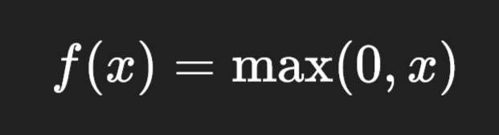
3. Activation Function (ReLU)
Applies non-linearity so the model can learn complex patterns.
Usually, ReLU (Rectified Linear Unit) is used:

Slide 83
4. Pooling Layer
Reduces the size of the feature maps (i.e., dimensionality), making the model faster and less prone to overfitting.
Most common: Max Pooling (takes the largest value from a region).
💡 Think of pooling as shrinking the image while keeping the most important parts
5. Flatten Layer
Converts the 2D feature maps into a 1D vector to feed into a fully connected layer.

Slide 84
6. Fully Connected (Dense) Layer
Works like a regular neural network — combines learned features to make predictions (e.g., classifying an image as a cat, dog, etc.).
7. Output Layer
Usually uses softmax activation for classification tasks.
Gives probability for each class (e.g., digits 0–9 in MNIST).

Slide 85
Real-life Example: Image Classification
Predicting whether an image is a cat or a dog.
Input image → [Cat]
CNN learns edges, eyes, ears, whiskers
Pooling keeps important features
Dense layer decides → High probability for "cat"

Slide 86
Applications of CNNs
Application | Use Case
Image recognition | Face detection, object detection
Medical imaging | Tumor detection from X-rays
Self-driving cars | Recognizing road signs, lanes
Security | Facial recognition, surveillance
Augmented Reality | Real-time object tracking

Slide 87
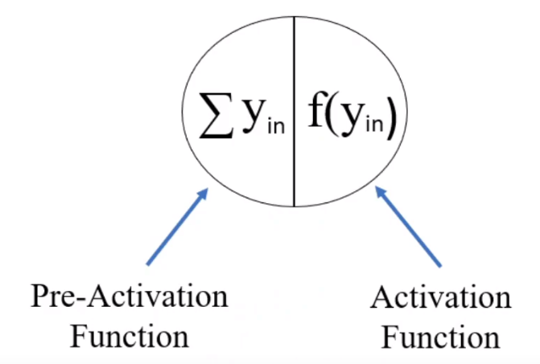
Activation Function:
The Activation Function is applied over the net input i.e, ysum to calculate the output of an ANN.
The activation function is a mathematical "Gate" in between the input feeding in the current node and it's output to the next layer.
As simple as, If I give you a problem and ask you to solve and tell me the answer, if and only if your answer is greater than 5.
So we are adding some criteria to the submission of the answer; if it meets that then only produce the output. This is called as Threshold Value.
Pre-Activation Function: (Summation Junction)
It is basically the summation of all the input as the net input and it passes the input to the function which is called as Activation function.

Slide 88
Why do we need Activation Function?
We use Activation Function to achieve non-linearity.
Nonlinear function are used to achieve the advantages of multilayer network, when an input passes through the multilayer network with linear activation function, the output remains same as that it could be obtained using a single layer network.
If we do not apply activation function then the ouput would be linear funciton, and that will be a Simple Linear Regression Model.

Slide 89
Recurrent Neural Network (RNN)
A Recurrent Neural Network (RNN) is a type of neural network designed to process sequential or time-series data, where the order of data matters.
Unlike traditional neural networks, RNNs have a "memory" — they remember past information and use it to influence the current output.
RNNs are used when the current input depends on previous inputs.
They have recurrent connections that allow information to persist over time, enabling them to capture temporal dependencies in data.
RNNs are commonly used for tasks such as natural language processing (e.g., language modeling, machine translation), speech recognition, and sequence generation.
They are able to remember important things about the input they received and hence enables them to be more precise.

Slide 90
Real-Life Examples:
Application | Example
Language Processing | Predict the next word in a sentence
Time-Series Forecasting | Predict stock prices over time
Speech Recognition | Convert spoken words into text
Music Generation | Create music note by note based on previous notes

Slide 91
How RNN Works (Conceptually)
Let’s say you want to predict the next word in the sentence: "The sky is ___"
RNN processes this one word at a time:
First, it sees “The”
Then it remembers “The” and processes “sky”
Then it remembers “The sky” and processes “is”
Based on "The sky is", it predicts "blue"

Slide 92
Module-4: Advanced Machine Learning Techniques:
Ensemble Methods: Bagging and Boosting, Gradient Boosting Machines (GBM), Extreme Gradient Boosting (XGBoost).
Support Vector Machines (SVM): Linear and non-linear SVM, Kernel trick, Model evaluation and tuning.
Neural Networks and Deep Learning: Introduction to neural networks, Building and training neural networks using TensorFlow and Keras, Convolutional Neural Networks (CNN) and Recurrent Neural Networks (RNN).

